Slide 1
Comilla University Laplace Transformation & Fourier Series
Submitted to:
Dr. Md Gulam Murtaza Talukdar
Associate Professor,
Dept. Of Mathematics.
Submitted by:
Jewel Nath
ID : 11909037
Dept. Of ICT

Slide 2
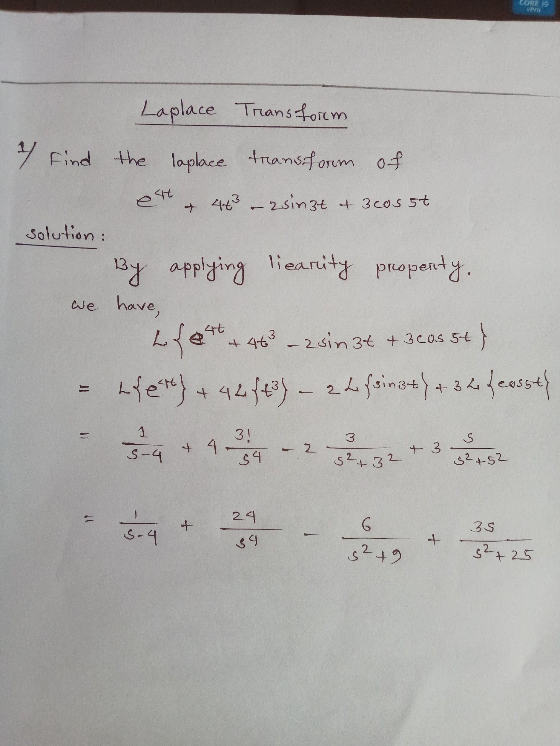

Slide 3
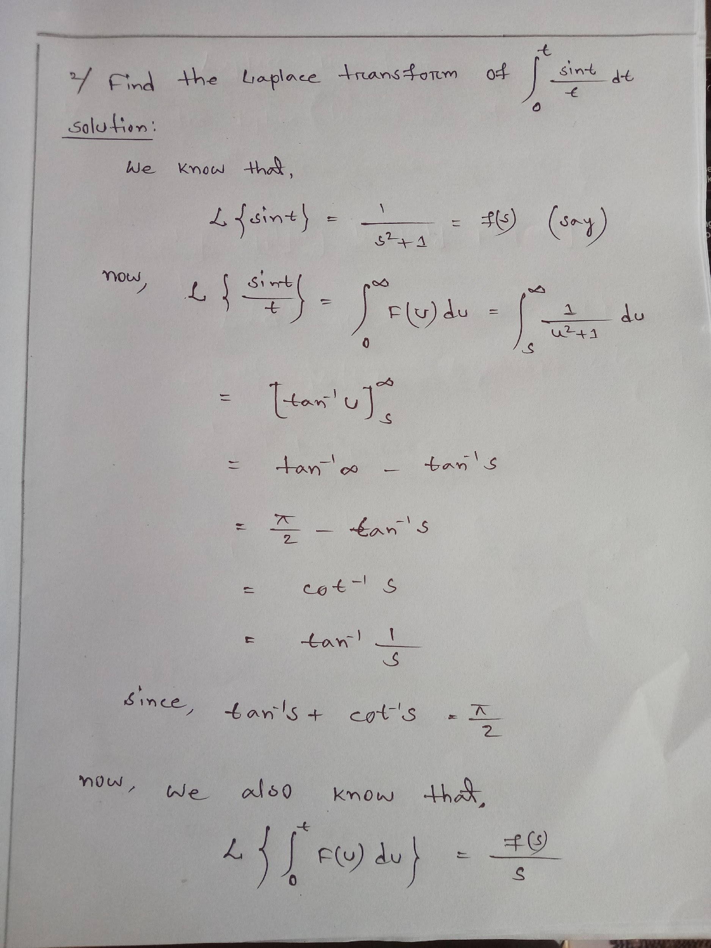

Slide 4
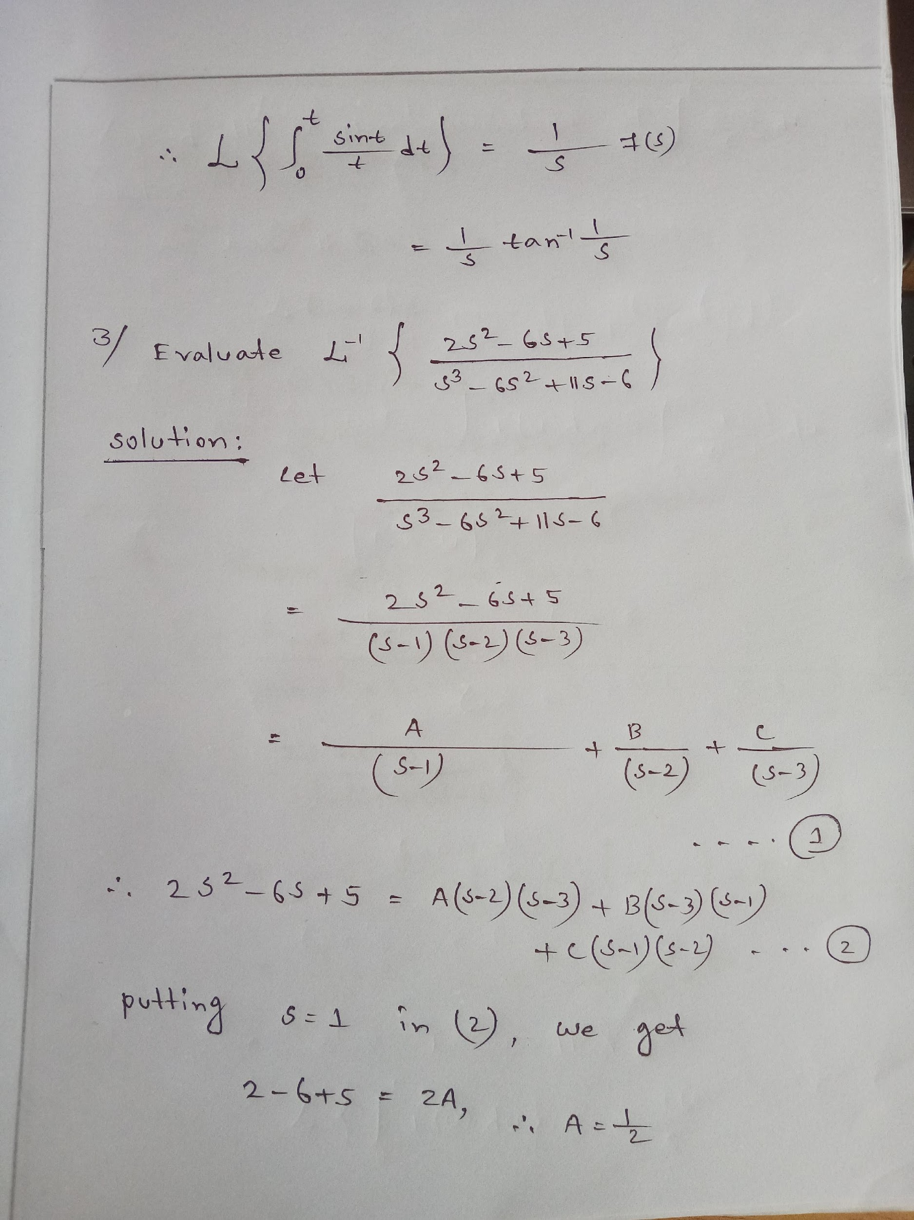

Slide 5
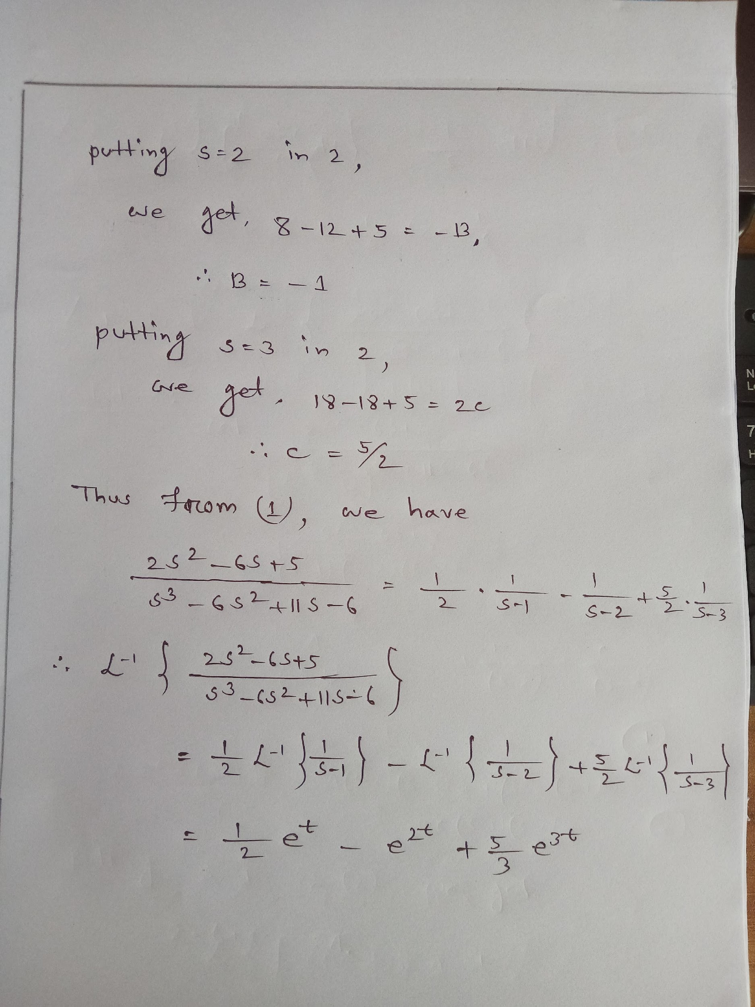

Slide 6
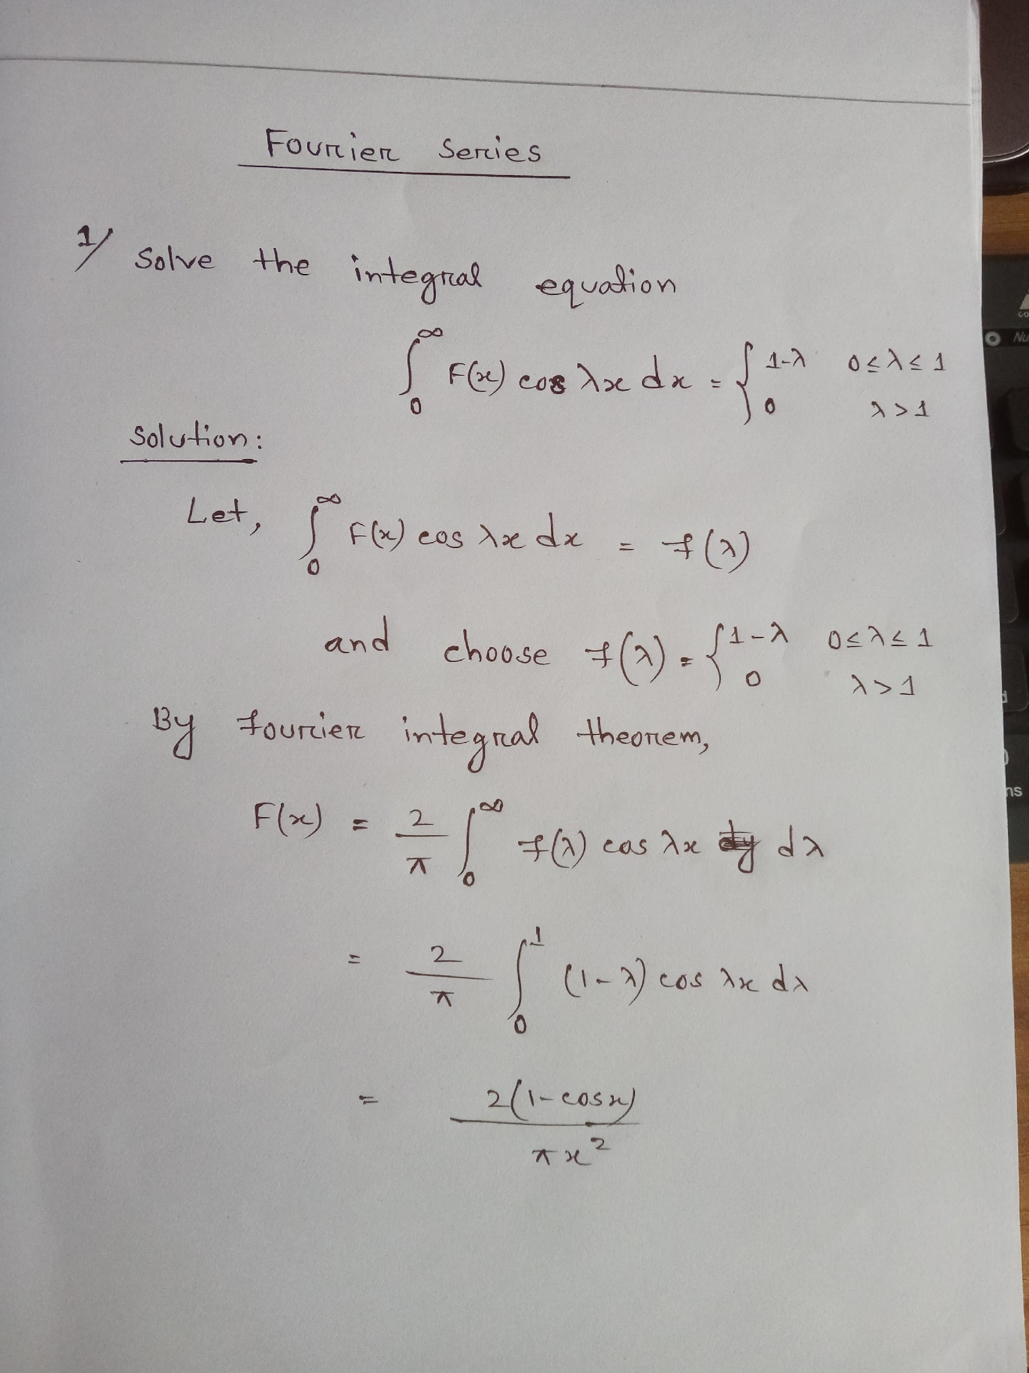

Slide 7
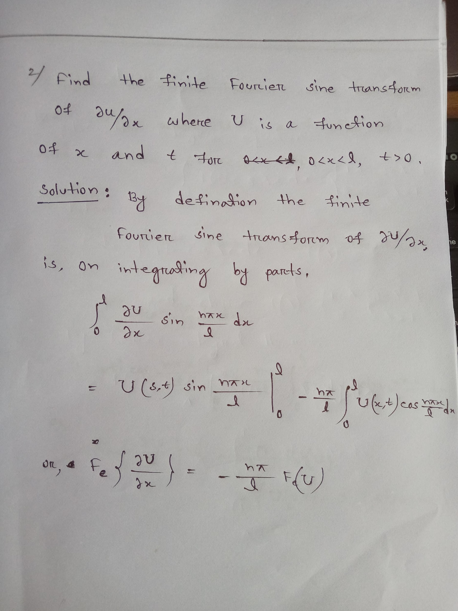

Slide 8
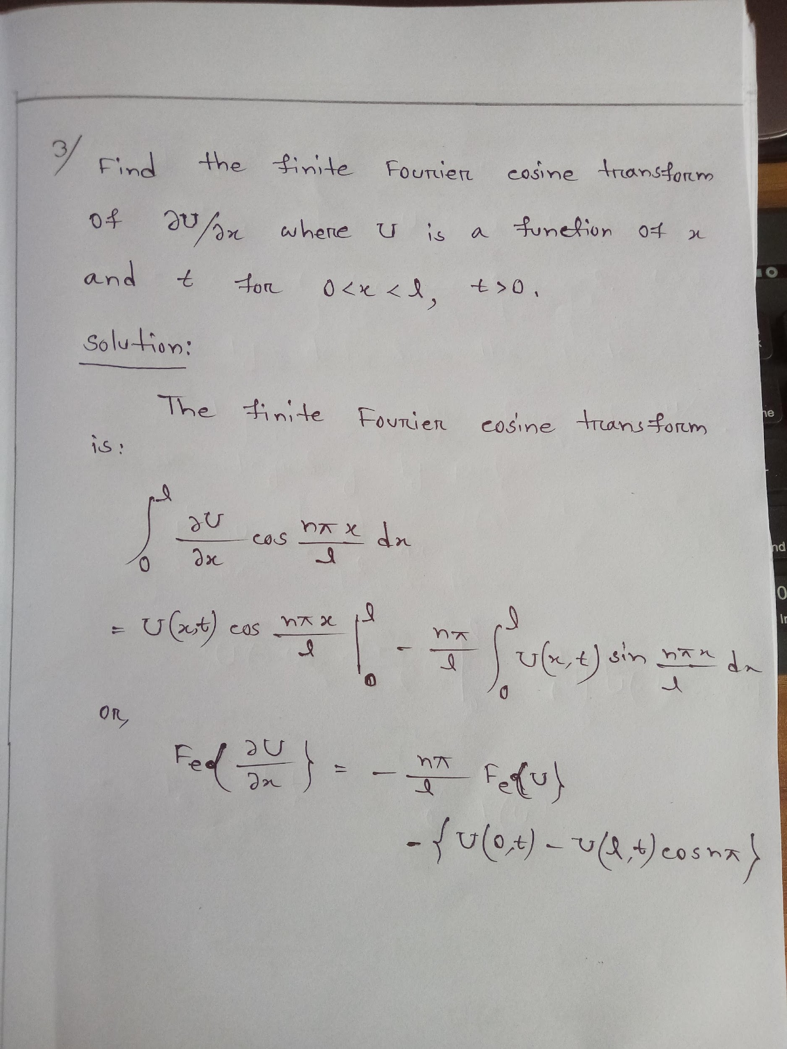

Slide 9
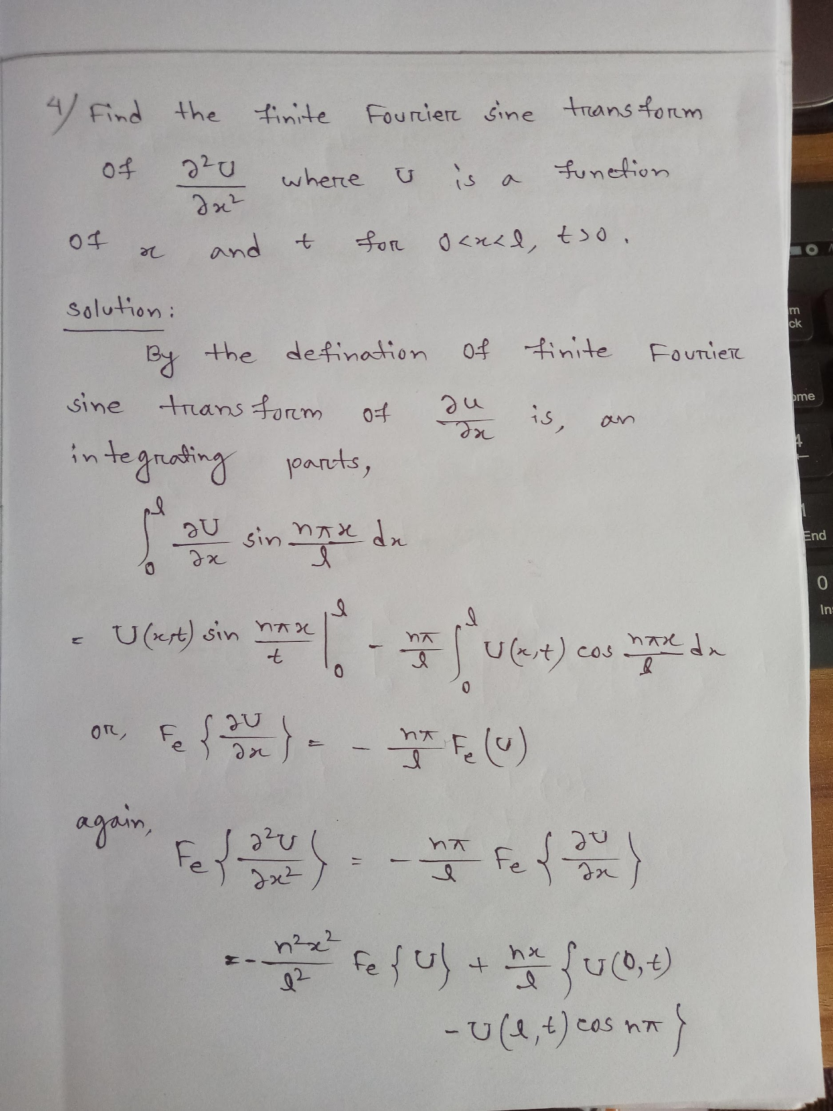

Slide 10
